Slide 1
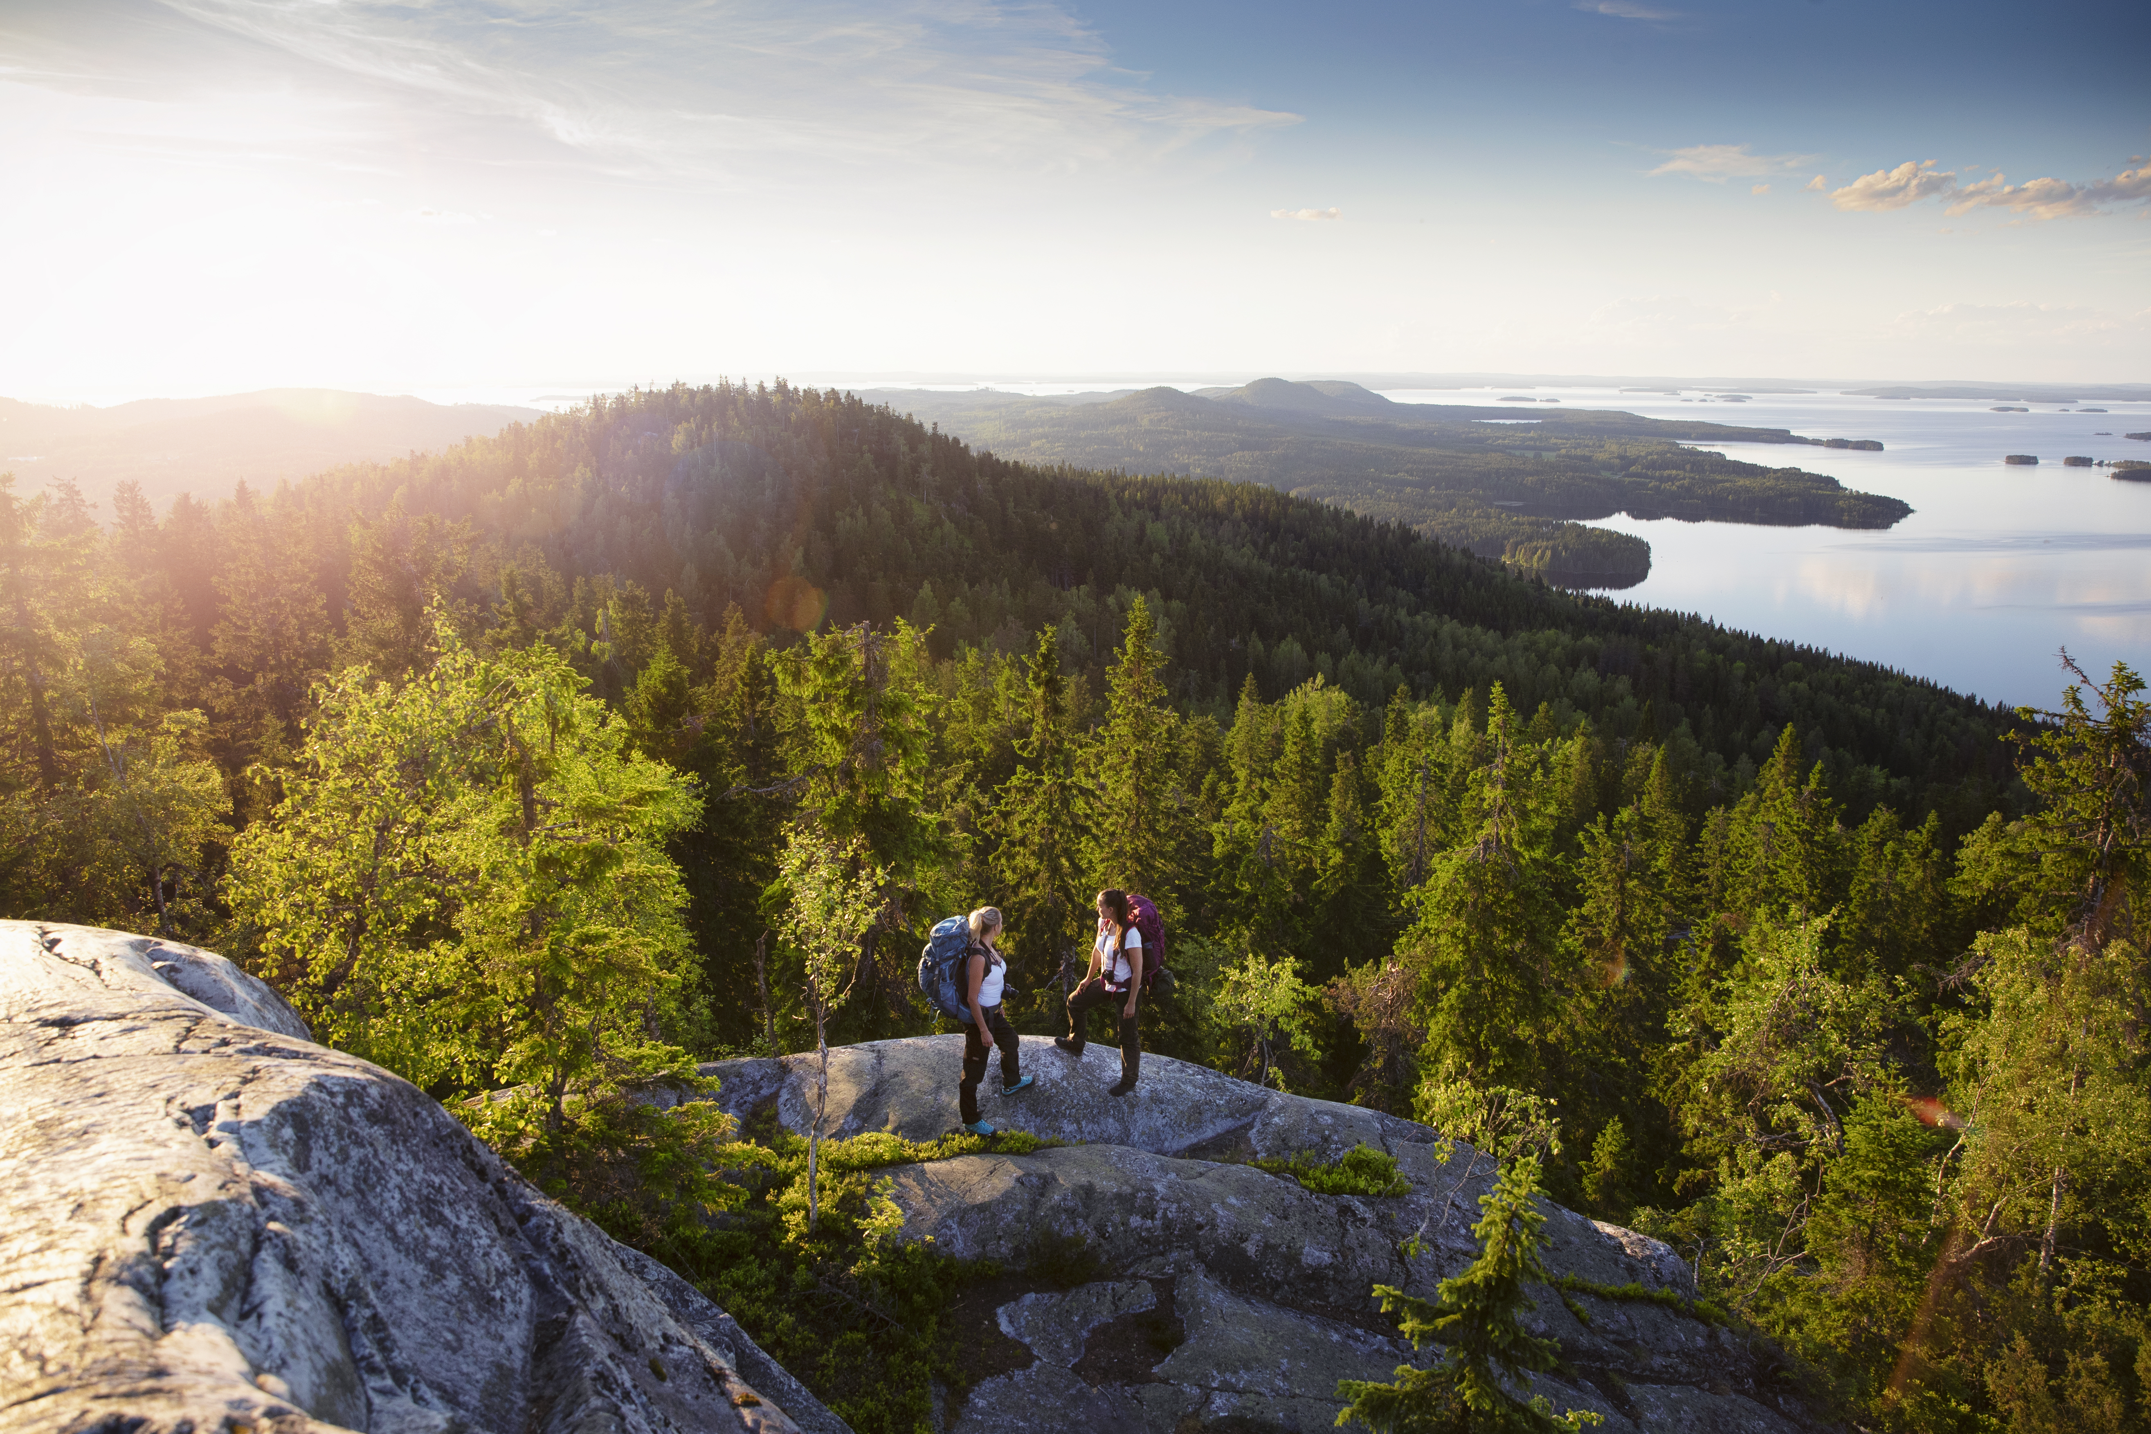




North Karelian Cuisine
Exploring forests and wild food for traditional and modern culinary adventures
Antti Rämö
chef

Slide 2
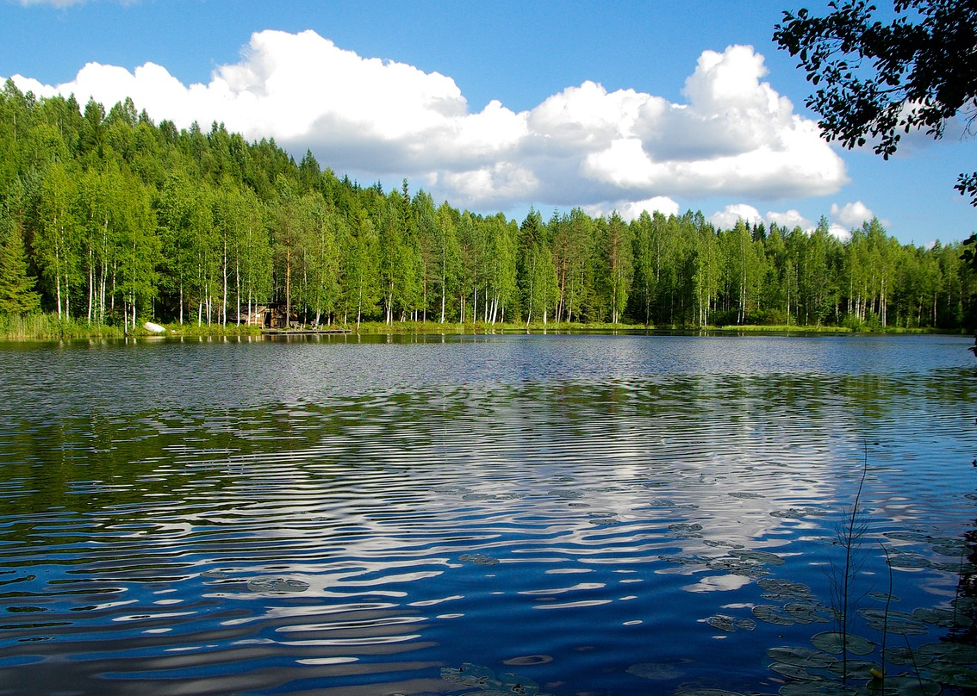
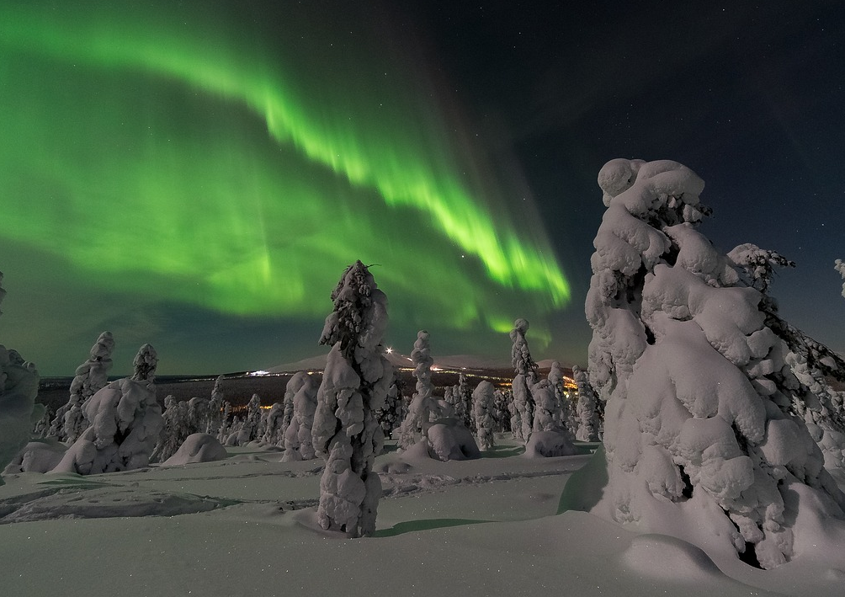
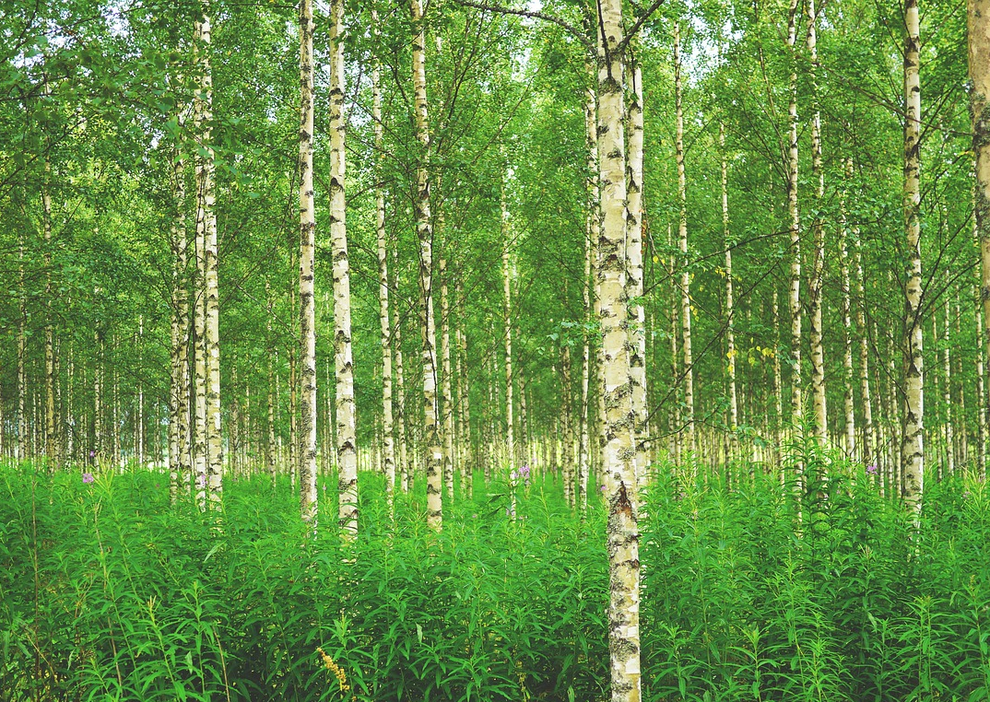
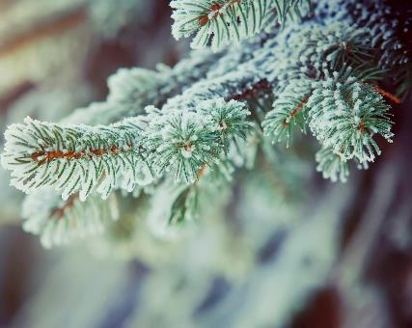
Content
Introduction to North Karelian food culture
The Forest as a pantry
Wild food opportunities in North Karelia
Traditions and innovations meet in modern North Karelian cuisine
Sustainability and local sourcing
Highest quality food from the happiest people in the world
Recipes from the Forest
Discover the culinary delights of North Karelia

Slide 3
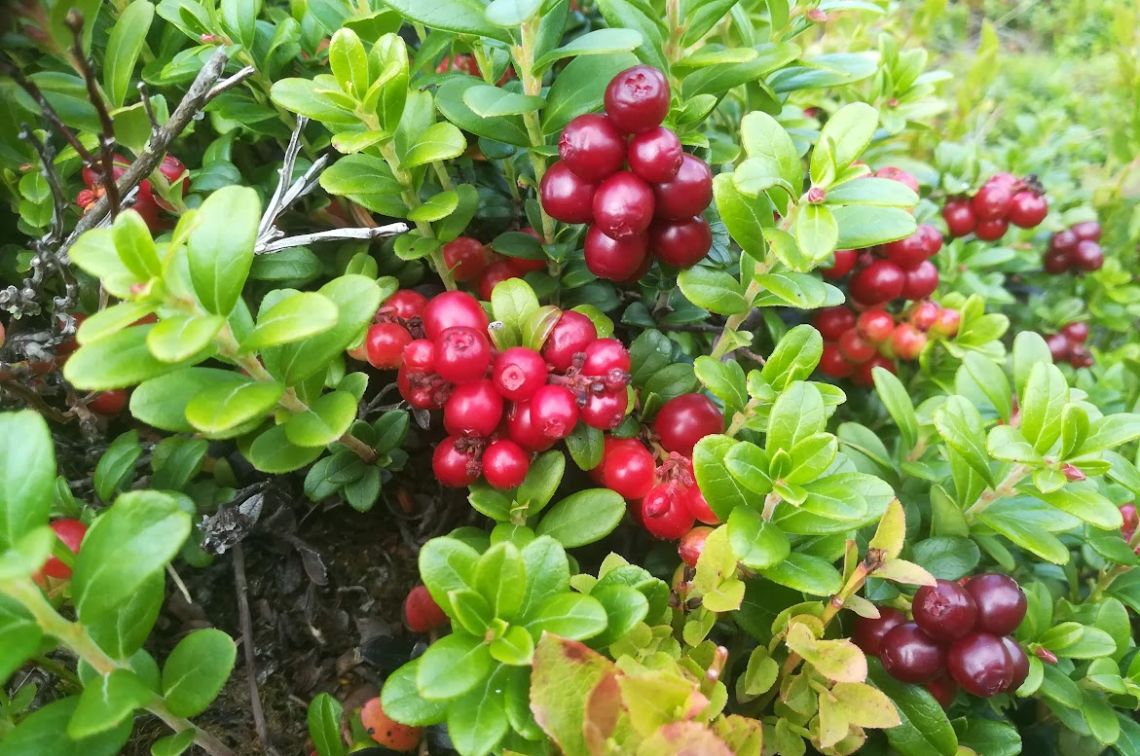
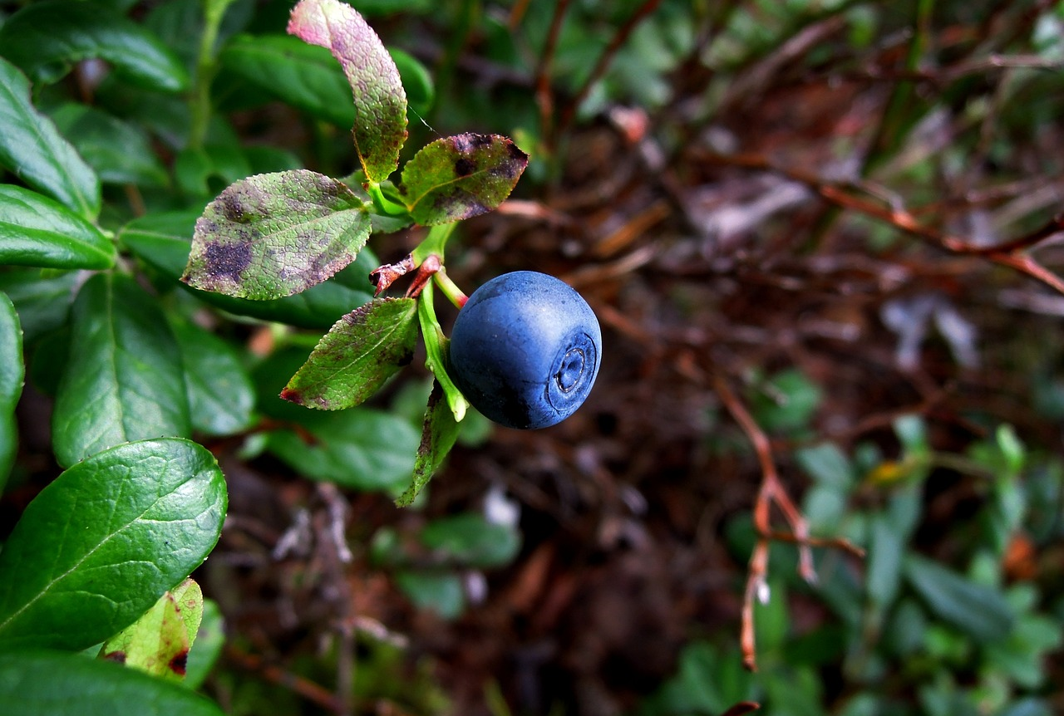
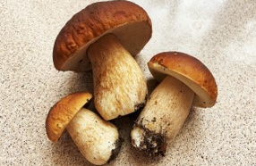
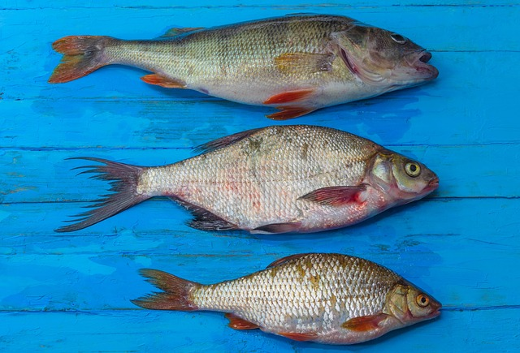
Introduction to North Karelian Food Culture
Local Ingredients
Forests in North Karelia provide an abundance of wild foods, such as berries (bilberries, lingonberries, cloudberries), mushrooms (chanterelles, porcini), and herbs.
Game and meat: Wild game, such as elk, hare, wild birds and small-scale farming products like pork and beef also feature in many traditional dishes, often cooked in hearty stews or roasted.
Fish: Lakes and rivers offer fish such as perch, pike, and vendace, which are often prepared using traditional techniques like smoking and pickling.
These ingredients have been staples in Karelian cooking for centuries, appearing in everything from simple stews to more elaborate desserts and preserves.

Slide 4
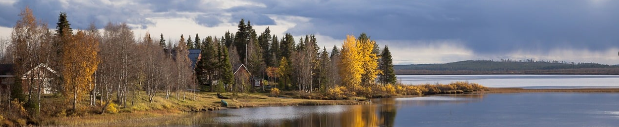
Seasonal Focus
Tradition of preserving food; drying, salting, fermenting, and pickling. Berries are turned into jams and syrups, while mushrooms and vegetables are dried or freezed for use in winter.
Dishes like Karelian pies (rice-filled pastries wrapped in thin rye dough) and kalakukko (a fish and pork pie encased in rye bread) are examples of how the cuisine emphasizes warmth and sustenance during colder periods.
Introduction to North Karelian Food Culture
Simplicity and Freshness
Simple preparation methods enhance the natural flavours of the ingredients, such as boiling, roasting, and stewing.
Focus on bringing out the best of what the land offers without excessive seasoning or complex processes

Slide 5
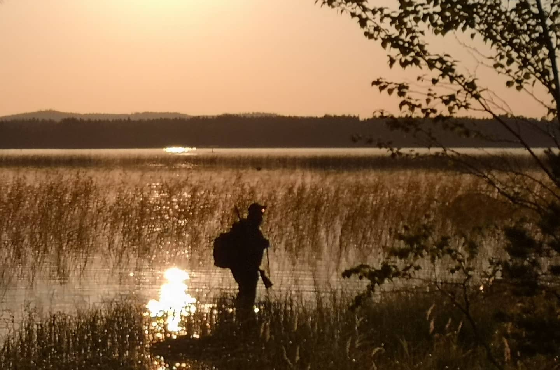
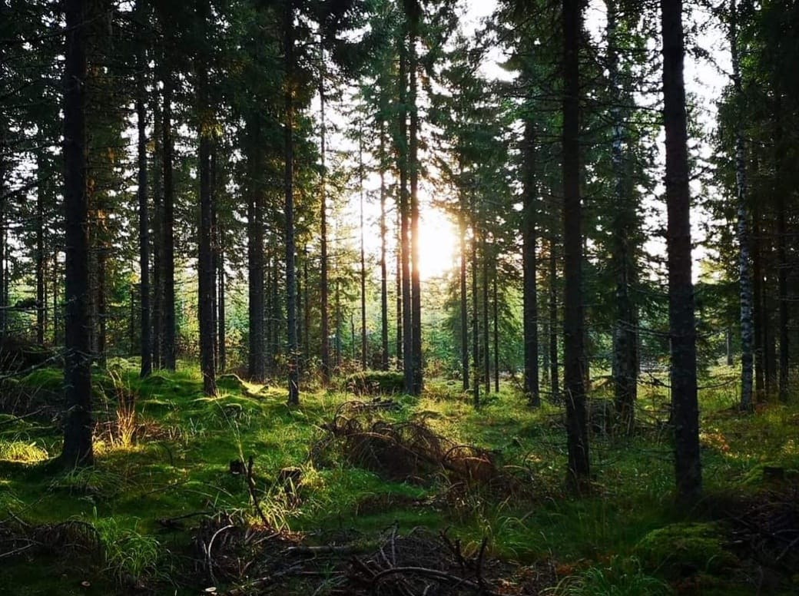

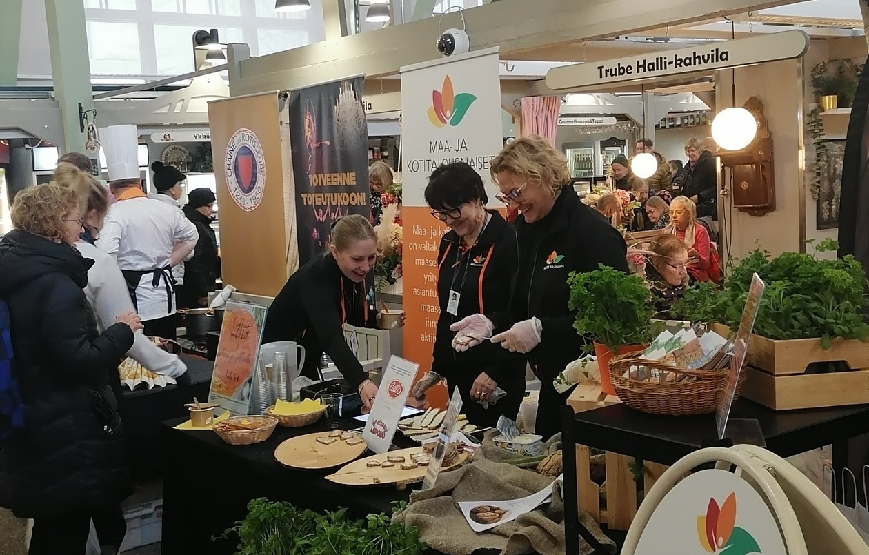
The Forest as a pantry
Forest has been a central part to local culture and cuisine for centuries in North Karelia.
The people have a deep connection to the forest, not only as a source of food but also as a space for recreation and cultural expression.
“People live in the forest and from the forest”
Seasonal enjoyment and foraging traditions (incl. fishing, hunting)
Culinary usage (traditional vs modern)
Well-being effects of forests (stress reduction, immune system boost, mental clarity and relaxation, therapeutic benefits)
Cultural significance and lifestyle integration, ourdoor activities, urban proximity

Slide 6
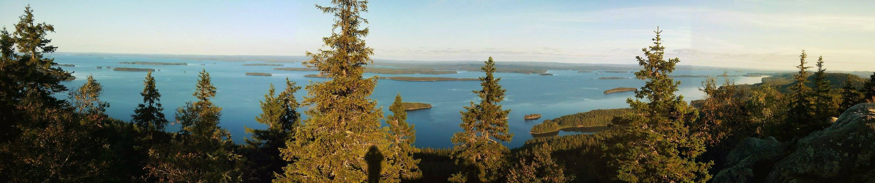
Wild food opportunities in North Karelia
Everyman’s Right
All people whether residing in Finland or just visiting have the right to
enjoy nature anywhere in the Finnish countryside regardless of land ownership.
pick wild berries, mushrooms and flowers, as long as they are not protected species
fish with a simple rod and line
Signature menus & dishes
Culinary experiences
Food gifts & souvenirs
Local food events
Local recipes & cooking books

Slide 7
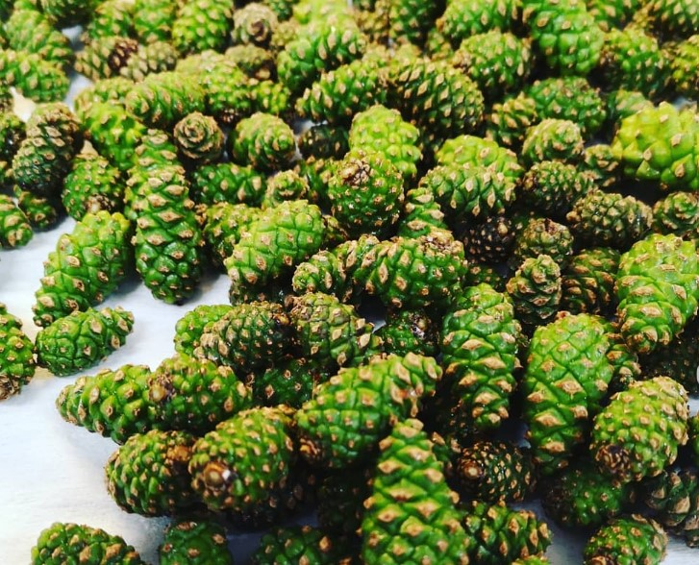
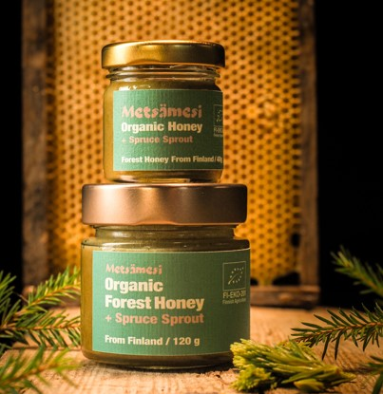
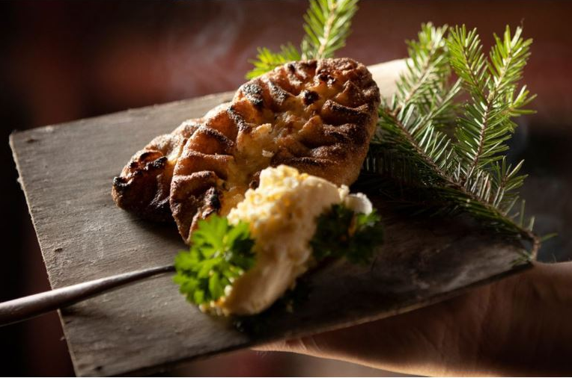
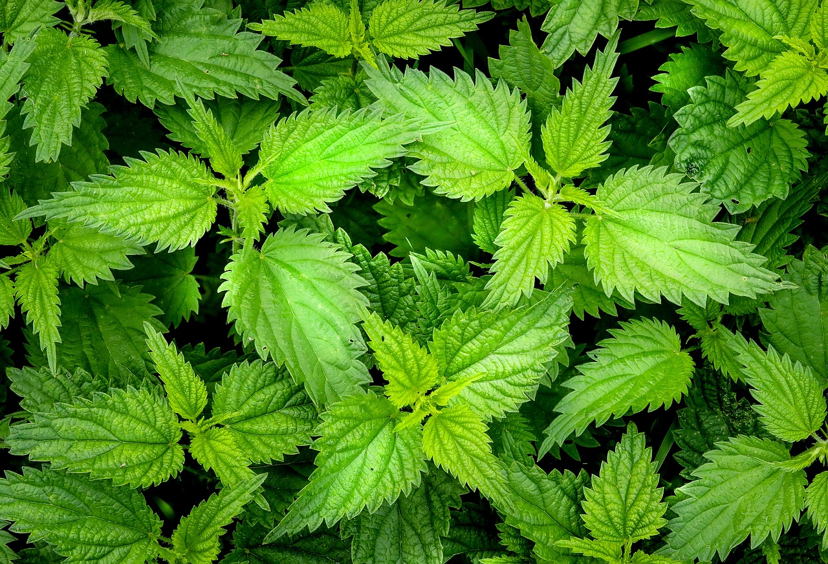
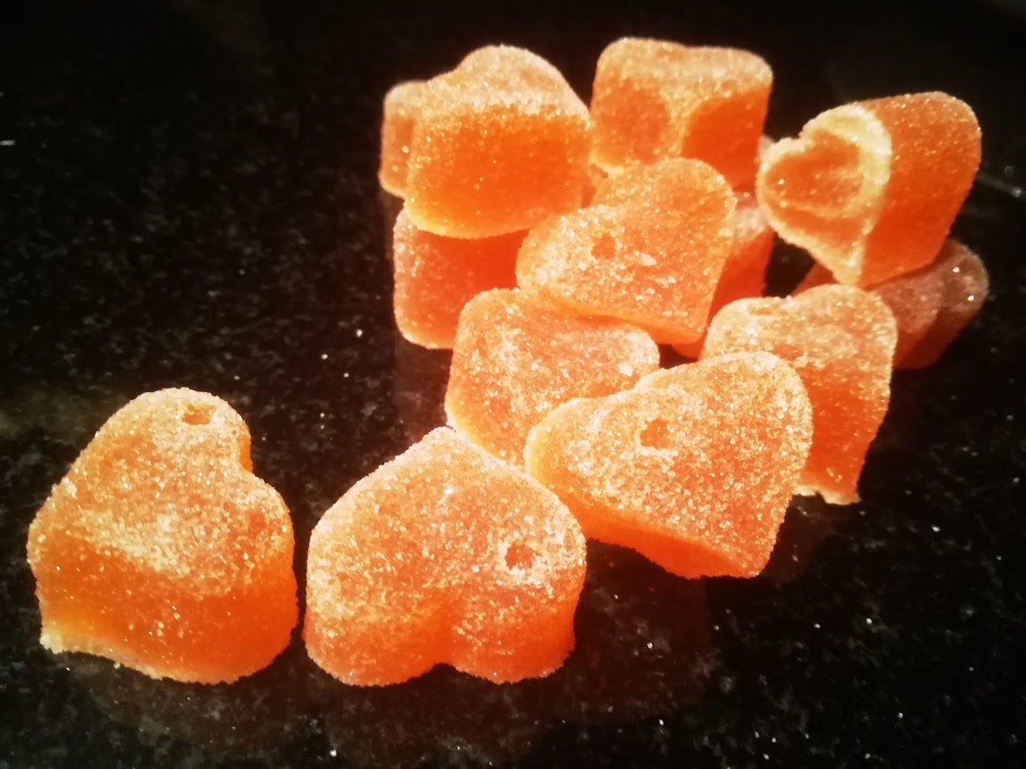
Traditions and innovations meet in modern North Karelian cuisine
Dishes
Karelian pies and other pastries, sugar salted pike-perch, smoked turnip & goat cheese soup, game stew
Delicaties
Pinecone jam, birch syrup, spruce sprout honey, herbal infusion, wild herb salt, berry or floral flavored sugar
Restaurants:
Bomba, Bistro Ohto (Nurmes), Tervaskanto, Grill it! Koli (Lieksa), Aittaranta (Joensuu)

Slide 8
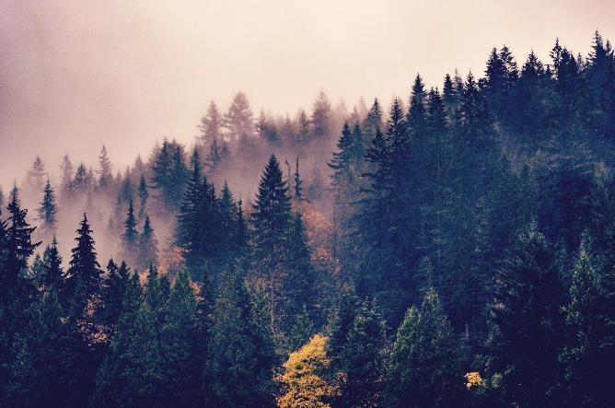
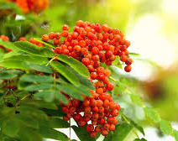
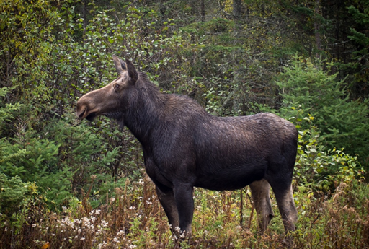
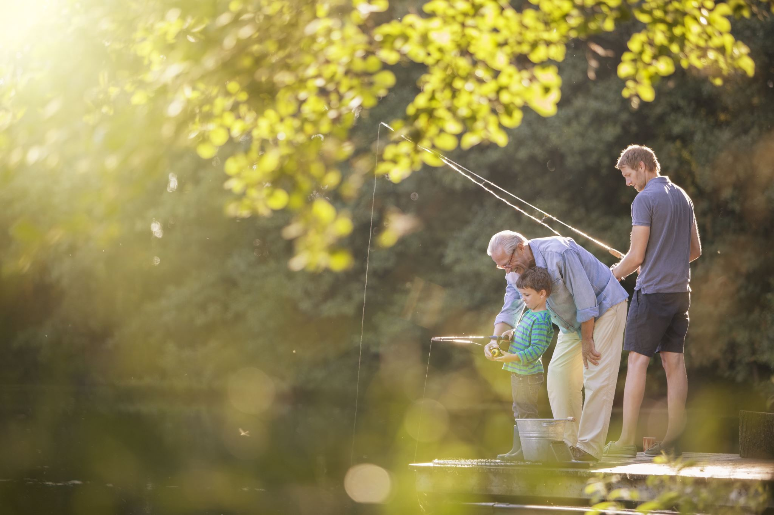
Sustainability and Local Sourcing
Foraging
Nutrient and flavour-rich food
Environmental, economic and community benefits
Hunting
Sustainable game use involves adhering to legal hunting seasons and quotas set by wildlife management authorities
Respect for animal welfare, minimizing waste by utilizing all edible parts of the animal
Fishing
Selective fishing, protecting endangered species
Innovative use of side stream or less-used species
Promoting game, fish and wild foods as part of a sustainable consumption encourages communities to reconnect with nature, respect local biodiversity, and reduce reliance on industrial agriculture
Local sourcing reduces the carbon footprint, supports the local economy and helps preserve traditional food practices

Slide 9
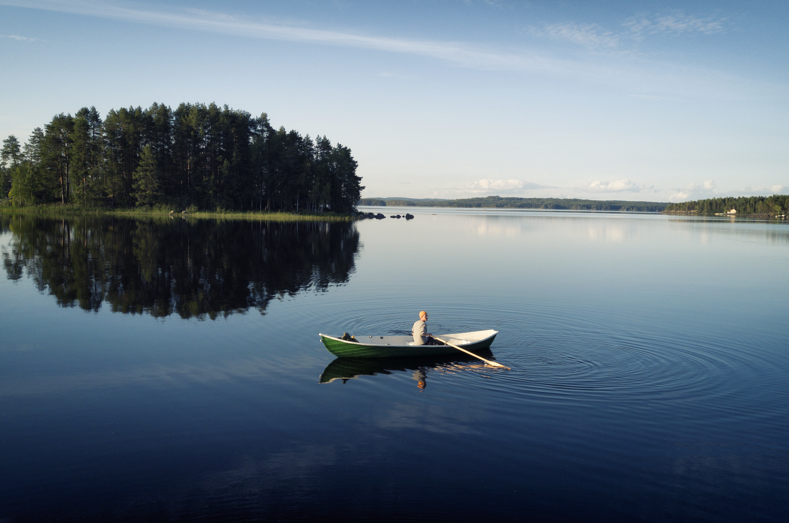
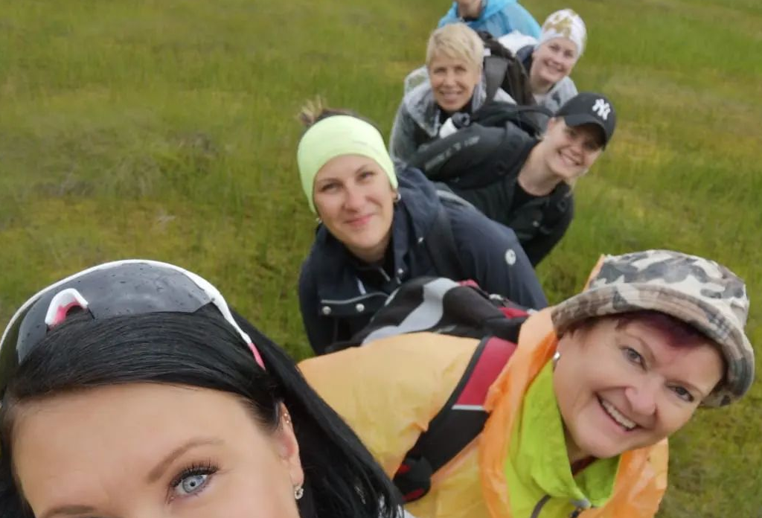
Highest quality food from the happiest people in the world
High quality water
Finland is uniquely rich in surface waters, and ranks amongst the best in the world for its tap water quality
Clean and environmental friendly
About 42% of Finland's energy comes from renewable energy resources
prioritizes forest and wildlife conservation
Cold winters provide natural protection against pests and fungi
The cleanest air in the World
Happiest country in the world
Democracy, full protection of human rights, accountability but also nature and sauna

Slide 10
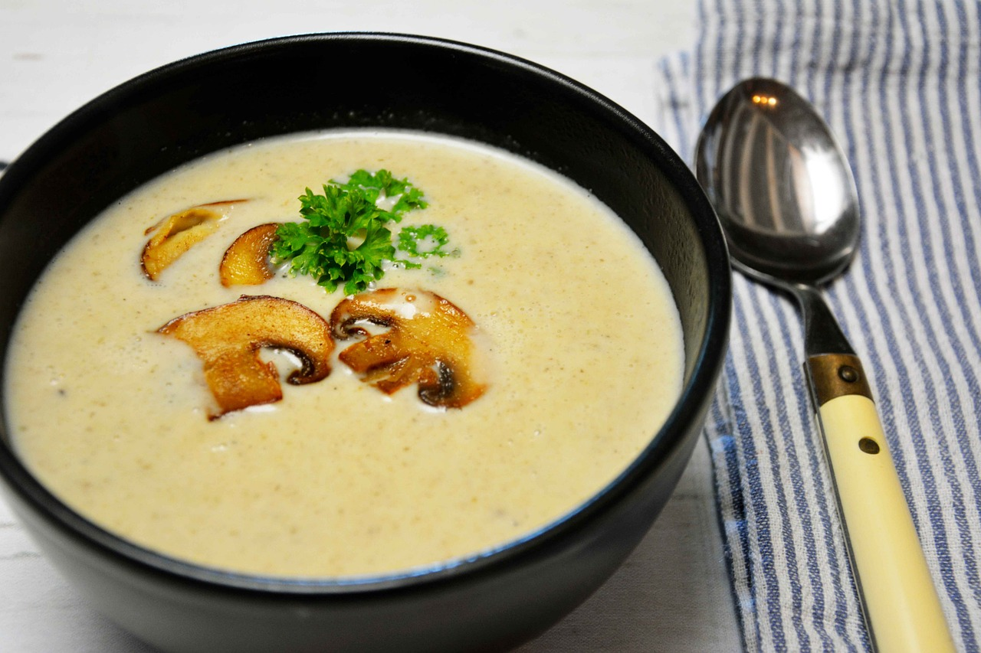
Recipe from the forest
Forest mushroom soup
Ingredients:
200g fresh wild mushrooms
(e.g., chanterelles or porcini)
1 small onion finely chopped
2 cloves garlic, minced
500ml vegetable broth
200ml cream
2 tablespoons butter
Salt and black pepper, to taste
Fresh parsley, chopped (for garnish)
Instructions:
Clean the mushrooms and chop them into bite-sized pieces.
Let the mushrooms cook in pan until extra liquid has vapored. Set a side.
In a pot, melt the butter over medium heat. Add the onion and garlic, sautéing until soft.
Add the mushrooms to the pot and cook for about 5 minutes.
Pour in the vegetable broth, bring to a boil, then reduce the heat and simmer for 10 minutes.
Stir in the cream and season with salt and pepper. Simmer for an additional 5 minutes.
Serve hot, garnished with fresh parsley

Slide 11
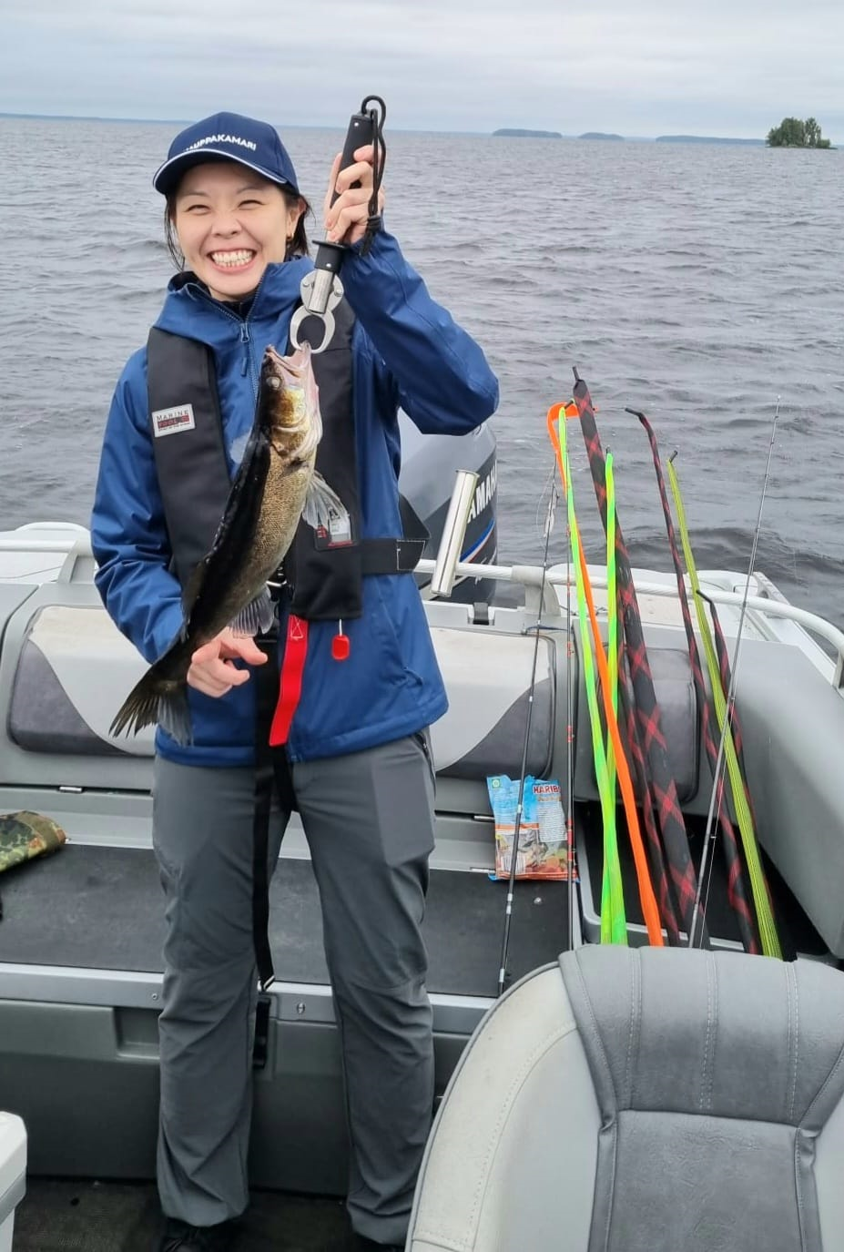
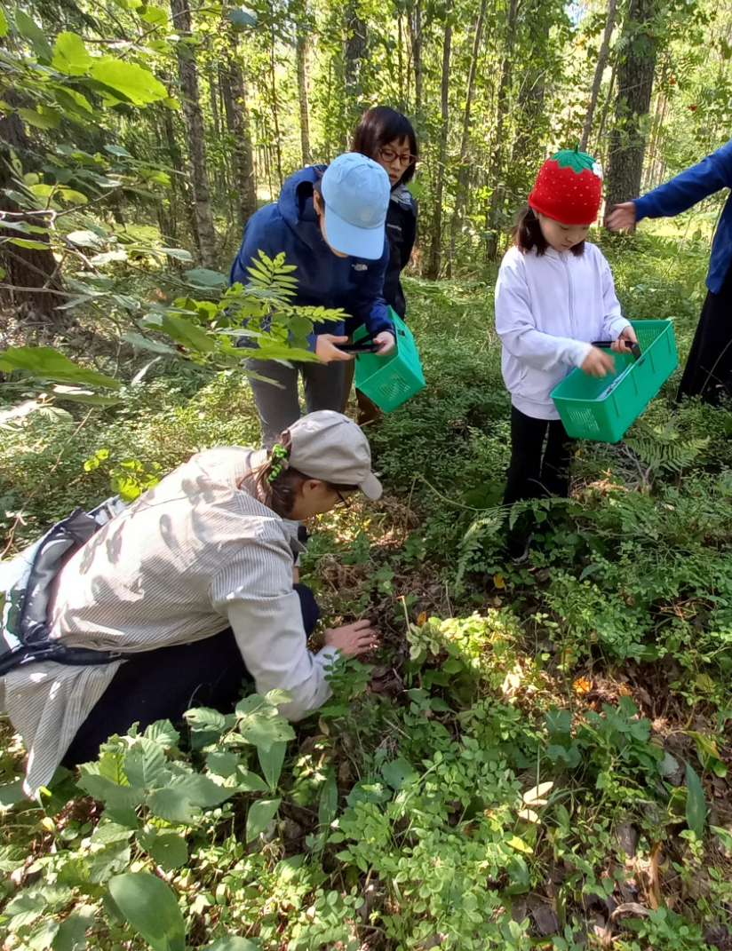
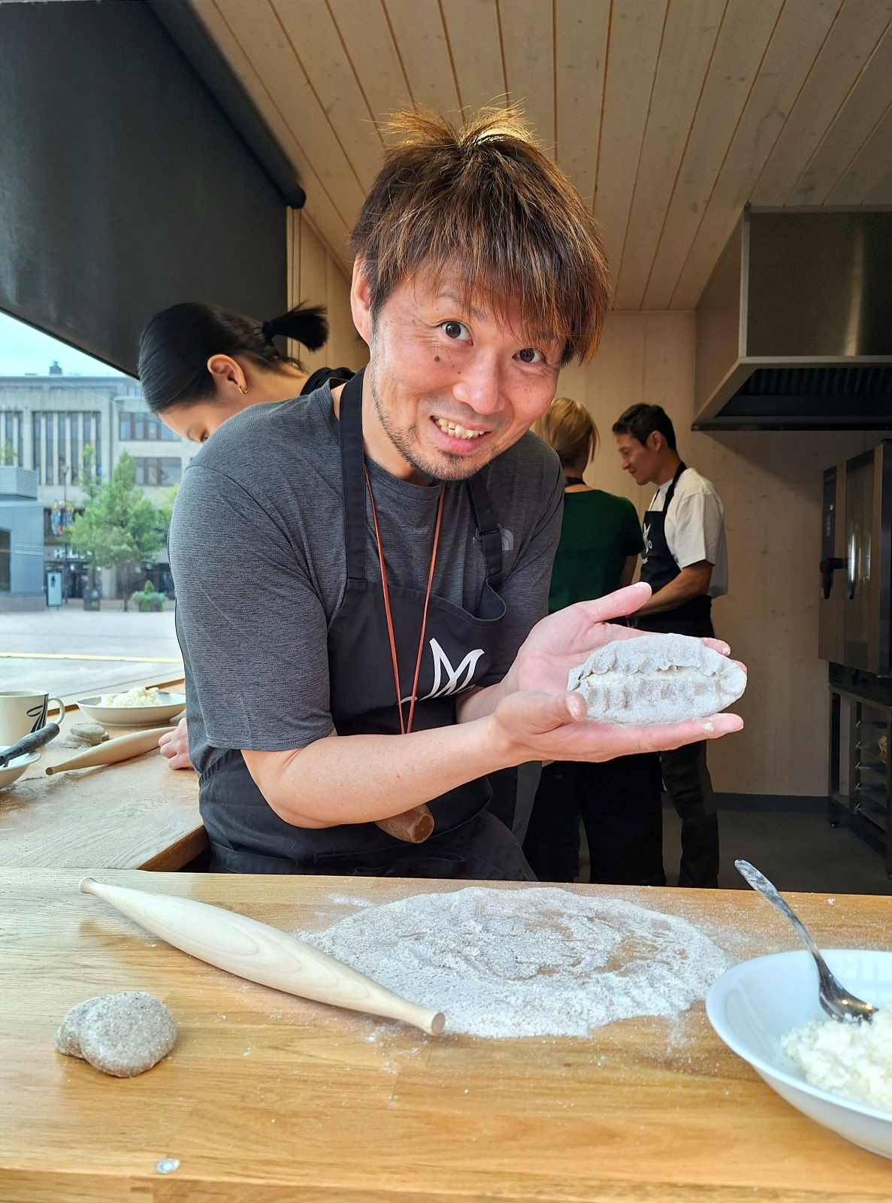
Discover the culinary delights of North Karelia
Plan Your Visit
Accessible from Helsinki (plane, train, bus, rental car)
City of Joensuu as the regional hub
DMO VisitKarelia for more info
Highlights
A hidden gem in the Finnish Lakeland
Pristine lakes, lush forests, four distinct seasons
Part of European Region of Gastronomy Saimaa 2024
Cuisine
Rich cultural heritage
High-quality, locally sourced ingredients
Blend of traditional and modern culinary techniques
Famous for its traditional bread and pastry selections
Award winning distilleries & breweries
Karelia á la Carte network
Unique Culinary Experiences & Events
Karelian pastry workshops
Cooking classes
Traditional Karelian food experiences
Berry & mushroom foraging
Fishing trips, outdoor cooking
Artisanal spirit and craft beer tastings
Food festivals & events
Local food shops, factory stores, farm visits

Slide 12
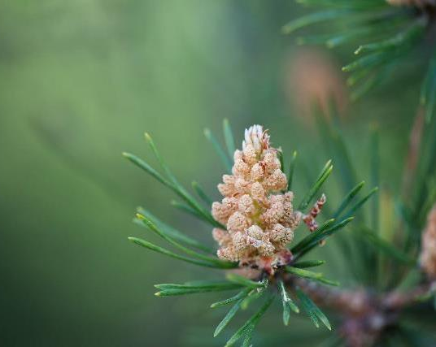
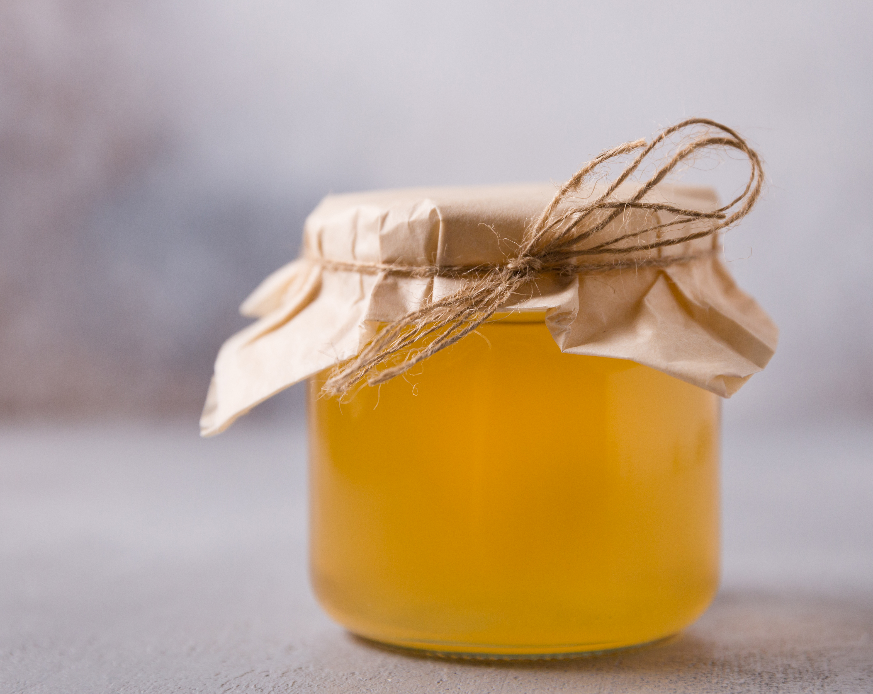
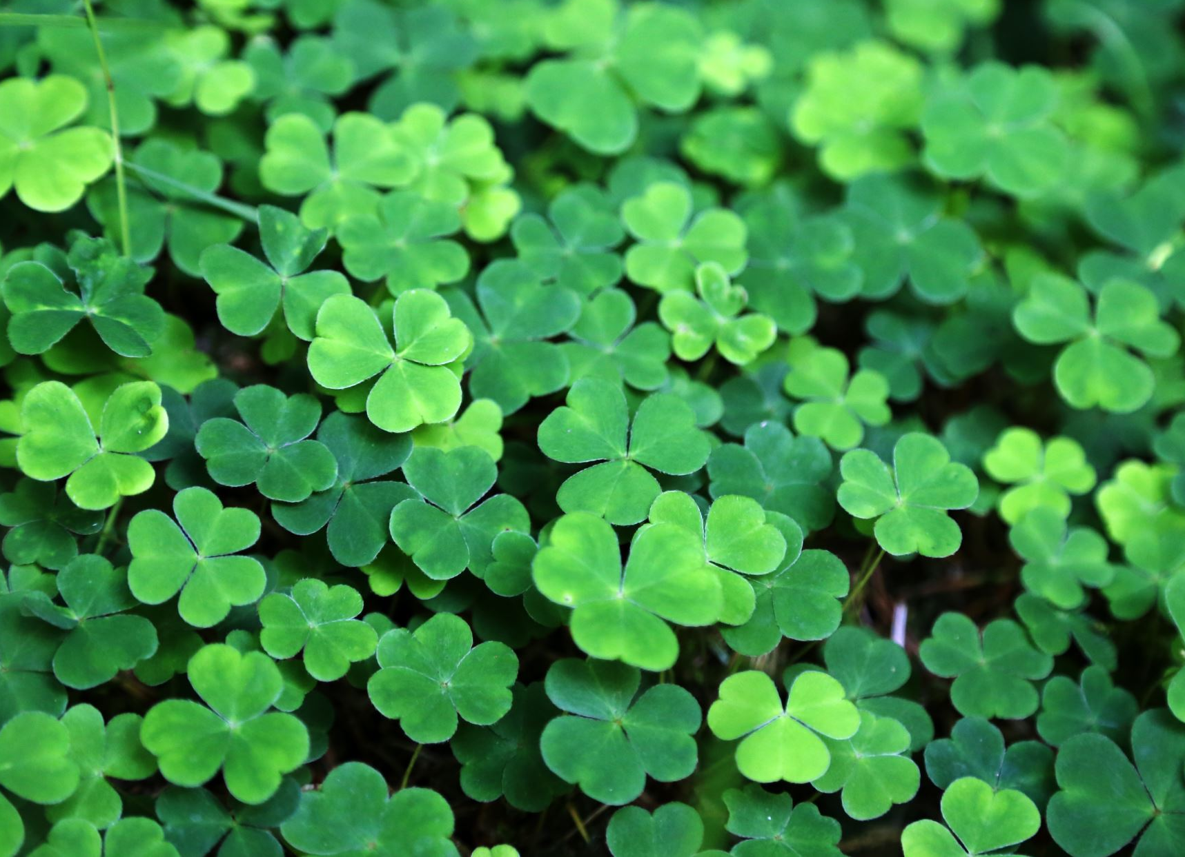
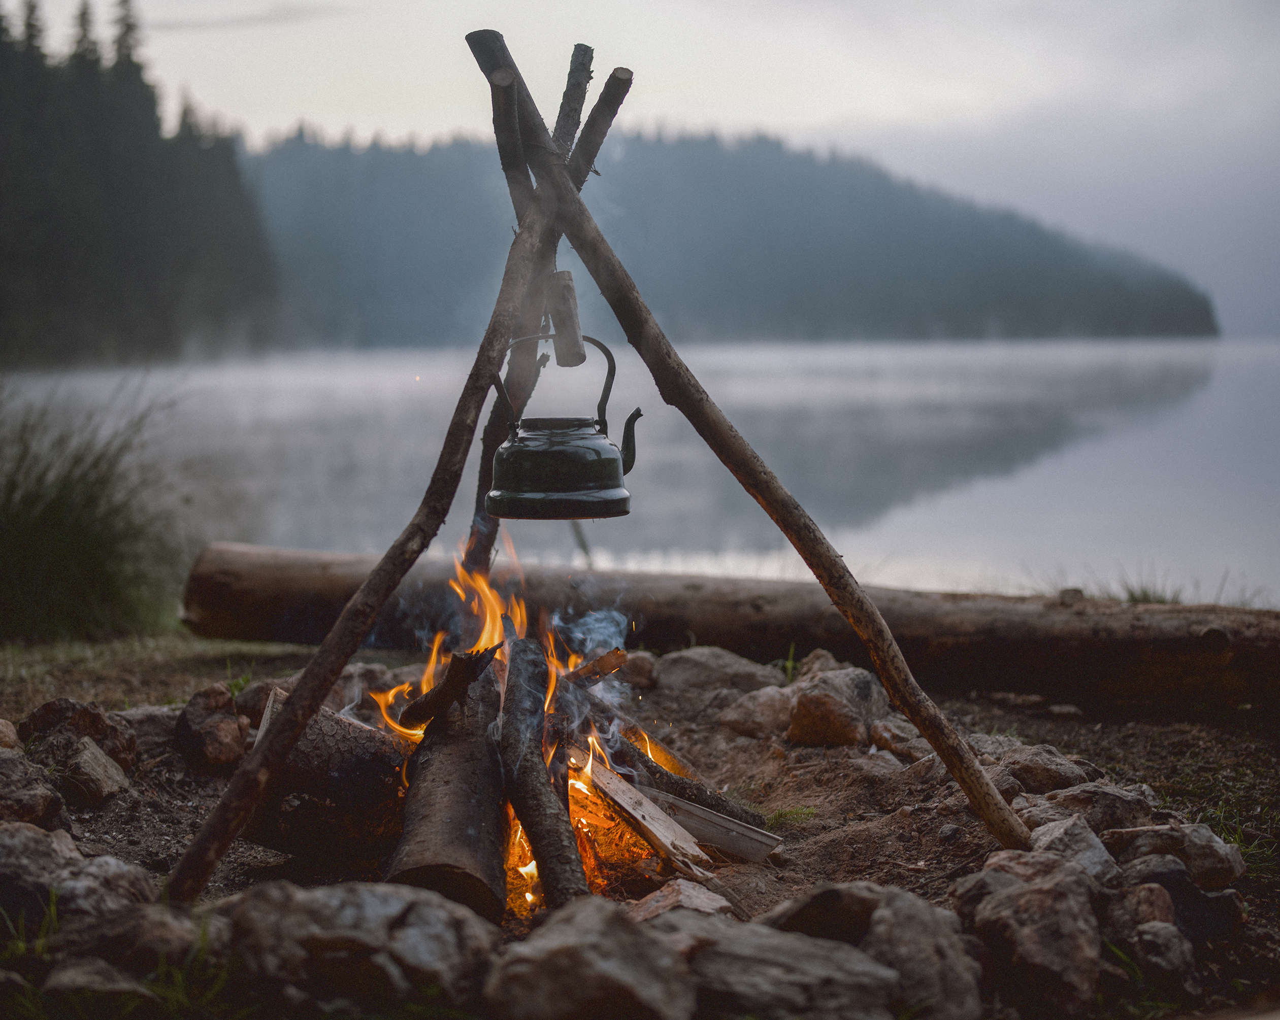

Welcome!
Eat, experience, enjoy North Karelia

Slide 13
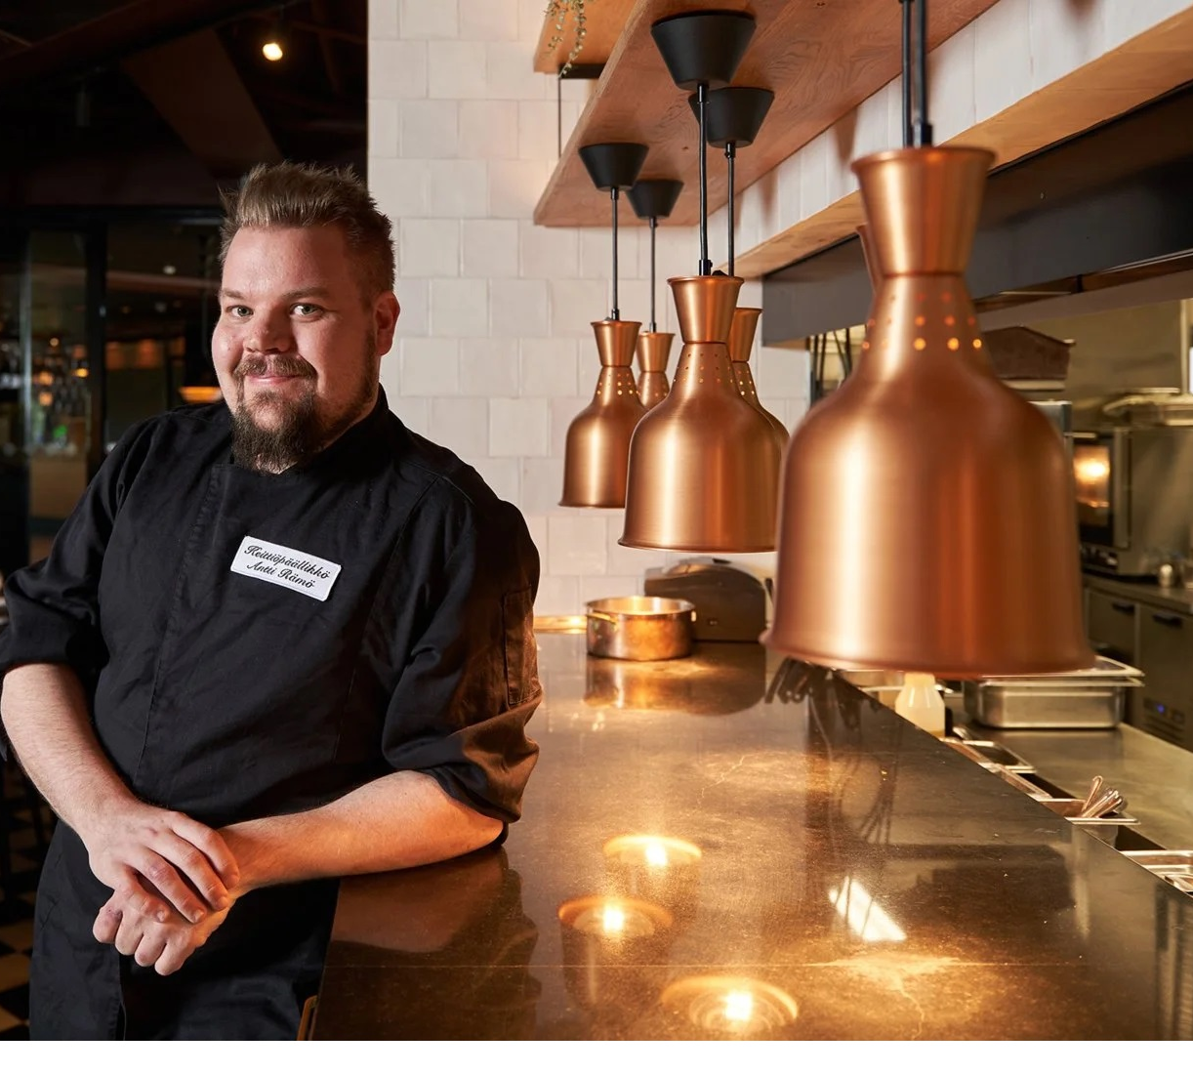
Thank you
Antti Rämö
antti.ramo@sok.fi

